Slide 1
What is http…?

Slide 2

HTTP stands for Hyper Text Transfer Protocol
Communication between client computers and
web servers is done by sending HTTP Requests
and receiving HTTP Responses
Purpose of HTTP
HTTP was invented alongside HTML to create the first interactive, text-based web browser: the original World Wide Web.
Today, the protocol remains one of the primary means of using the Internet.

Slide 3
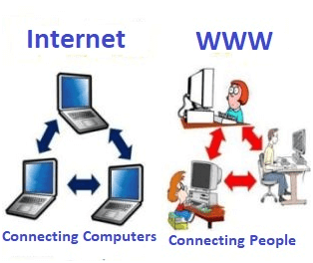
World Wide Web Communication
The World Wide Web is about communication between
web clients and web servers.
Clients are often browsers (Chrome, Edge, Safari), but
they can be any type of program or device.
Servers are most often computers in the cloud.

